Slide 1

Gifted to Build
Exodus 31:1-11

Slide 2
Exodus 31:1-11 (NASB)
¹ Now the LORD spoke to Moses, saying, ² "See, I have called by name Bezalel, the son of Uri, the son of Hur, of the tribe of Judah. ³ "And I have filled him with the Spirit of God

Slide 3
Exodus 31:1-11 (NASB)
in wisdom, in understanding, in knowledge, and in all kinds of craftsmanship, ⁴ to create artistic designs for work in gold, in silver, and in bronze, ⁵ and in the cutting of stones for settings, and in the carving of wood,

Slide 4
Exodus 31:1-11 (NASB)
so that he may work in all kinds of craftsmanship. ⁶ "And behold, I Myself have appointed with him Oholiab, the son of Ahisamach, of the tribe of Dan; and in the hearts of all who are skillful I have put skill,

Slide 5
Exodus 31:1-11 (NASB)
so that they may make everything that I have commanded you: ⁷ the tent of meeting, the ark of testimony, the atoning cover that is on it, and all the furniture of the tent, ⁸ the table and its utensils, the pure gold lampstand with all its utensils,

Slide 6
Exodus 31:1-11 (NASB)
and the altar of incense, ⁹ the altar of burnt offering with all its utensils, and the basin and its stand, ¹⁰ the woven garments as well: the holy garments for Aaron the priest and the garments of his sons, with which to carry out their priesthood;

Slide 7
Exodus 31:1-11 (NASB)
¹¹ the anointing oil also, and the fragrant incense for the Holy Place, they are to make them according to everything that I have commanded you."

Slide 8
Spiritual Gifts are Given by God, meant for the Body, and Wasted when Withheld

Slide 9
God Never Calls Without Equipping
Spiritual Gifts Are Given by God to Build His Dwelling
Spiritual Gifts Are Given to Every Believer to Build Christ’s Body
Spiritual Gifts Strengthen the Church Only When They Are Used
Spiritual Gifts Bring Consequences When They Are Neglected

Slide 10
Point #1: Spiritual Gifts Are Given by God to Build His Dwelling
Hebrews 13:8 (NASB)
James 1:17 (NASB)
Ephesians 2:22 (NKJV)

Slide 11
Hebrews 13:8 (NASB)
Jesus Christ is the same yesterday and today, and forever.

Slide 12
James 1:17 (NASB)
Every good thing given and every perfect gift is from above, coming down from the Father of lights, with whom there is no variation or shifting shadow.

Slide 13
Ephesians 2:22 (NKJV)
in whom you also are being built together for a dwelling place of God in the Spirit

Slide 14
Spiritual Gifts are Given by God, meant for the Body, and Wasted when Withheld

Slide 15
Point #2: Spiritual Gifts Are Given to Every Believer to Build Christ’s Body
Romans 12:6-8 (NLT)
Ephesians 4:16 (NASB)

Slide 16
Romans 12:6-8 (NLT)
⁶ In his grace, God has given us different gifts for doing certain things well. So if God has given you the ability to prophesy, speak out with as much faith as God has given you.

Slide 17
Romans 12:6-8 (NLT)
⁷ If your gift is serving others, serve them well. If you are a teacher, teach well.
⁸ If your gift is to encourage others, be encouraging. If it is giving, give generously.

Slide 18
Romans 12:6-8 (NLT)
If God has given you leadership ability, take the responsibility seriously. And if you have a gift for showing kindness to others, do it gladly.

Slide 19

Spiritual Gifts Are categorized as follows:
Serving Gifts
Ministry
Giving
Ruling
Mercy
Preaching
Teaching
Exhortation

Slide 20
Ephesians 4:16 (NASB)
from whom the whole body, being fitted and held together by what every joint supplies, according to the proper working of each individual part, causes the growth of the body for the building up of itself in love.

Slide 21
Spiritual Gifts are Given by God, meant for the Body, and Wasted when Withheld

Slide 22
Point #3: Spiritual Gifts Strengthen the Church Only When They Are Used
Romans 12:4-5 (NLT)
Psalms 127:1 (NKJV)

Slide 23
Romans 12:4-5 (NLT)
4 Just as our bodies have many parts and each part has a special function,
5 so it is with Christ's body. We are many parts of one body, and we all belong to each other.

Slide 24
Psalms 127:1 (NKJV)
Unless the LORD builds the house, They labor in vain who build it; …

Slide 25
Spiritual Gifts are Given by God, meant for the Body, and Wasted when Withheld

Slide 26
Point #4: Spiritual Gifts Bring Consequences When They Are Neglected
I Timothy 4:14 (NASB)
I Corinthians 3: 16-17 (NASB)
Matthew 5:14-16 (KJV)

Slide 27
I Timothy 4:14 (NASB)
Do not neglect the gift that is in you, which was given to you by prophecy with the laying on of the hands of the eldership.

Slide 28
I Corinthians 3:16-17 (NASB)
¹⁶ Do you not know that you are a temple of God and that the Spirit of God dwells in you?
¹⁷ If anyone destroys the temple of God, God will destroy that person; for the temple of God is holy, and that is what you are.

Slide 29
Matthew 5:14-16 (KJV)
¹⁴ Ye are the light of the world. A city that is set on an hill cannot be hid. ¹⁵ Neither do men light a candle, and put it under a bushel, but on a candlestick; and it giveth light unto all that are in the house.

Slide 30
Matthew 5:14-16 (KJV)
¹⁶ Let your light so shine before men, that they may see your good works, and glorify your Father which is in heaven.

Slide 31
Spiritual Gifts are Given by God, meant for the Body, and Wasted when Withheld

Slide 32
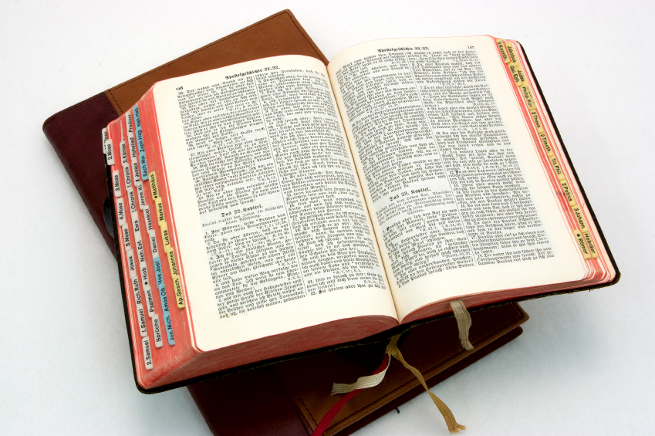
Hear: Romans 10:17
So then faith cometh by hearing, and hearing by the word of God.

Slide 33
Believe: Hebrews 11:6
But without faith it is impossible to please him: for he that cometh to God must believe that he is, and that he is a rewarder of them that diligently seek him.

Slide 34
Repent: Luke 13:3
I tell you, Nay: but, except ye repent, ye shall all likewise perish.

Slide 35
Confess: Matthew 10:32-33
32 Whosoever therefore shall confess me before men, him will I confess also before my Father which is in heaven.
33 But whosoever shall deny me before men, him will I also deny before my Father which is in heaven.

Slide 36
Baptize: Acts 22:16
And now why tarriest thou? arise, and be baptized, and wash away thy sins, calling on the name of the Lord.

